Slide 1


MARKET AND RETAIL ANALYTICS
OLIST
INVENTORY MANAGEMENT

Slide 2

AGENDA
Objective
Background
Key Findings / Insights & Recommendation
Appendix:
1) Data Assumption
2) Summary

Slide 3

OBJECTIVE
Company has faced some losses recently and they want to manage their inventory very well so as to reduce any unnecessary costs that they might be bearing.
Manage the inventory cost of company.
Analyse the purchase behavior of individual customers to estimate with relative certainty, what items are more likely to be purchased individually or in combination with some other products.

Slide 4




BACKGROUND
Optimizing inventory to maximize the revenue
It is assumed that the shipping charges are given by the customers
The company’s best seller Product is Toys throughout the years
Performed Market Basket analysis to get a better understanding of the costumer behavior

Slide 5
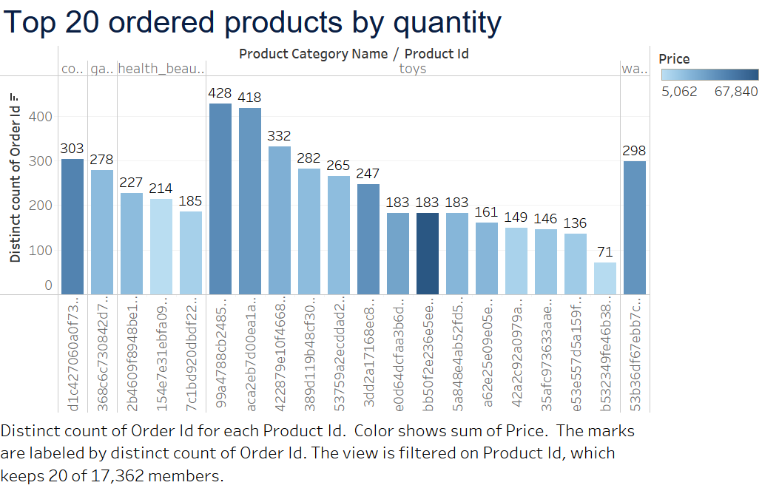
Key Findings & Recommendations
Top 20 Product Categories Ordered by Quantity
Top products that are ordered with respect to the quantity ordered.
Toys is a product that is ordered the maximum number of times and has the most products under the Top 20.
Computer Accessories, Garden Tools, Health/Beauty and Watches/gifts are also among top 20 products ordered by quantity

Slide 6
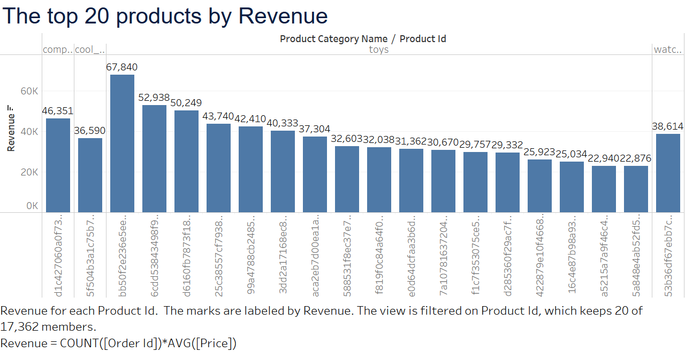
Top 20 Products by Revenue
Top 20 Products by Revenue consists of the product IDs that has generated highest revenue throughout the years.
Toys has generated most revenue as 17 of the product IDs out of 20 belong to toys, in which highest one made 67,840.
Computer Accessories, Cool Stuff and Watches/Gifts are also in the mix.

Slide 7
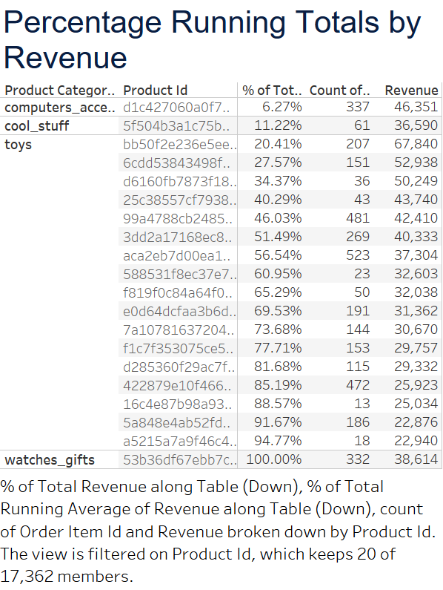
Running total of Revenue
Running Total by Revenue consists of 20 product IDs with Computer Accessories, Cool Stuff, Toys and Watches/Gift as product categories.
Toys on its own consists of more than 70% of the revenue generated by the company. (More proofs in coming slides)
Computer Accessories, Cool Stuff, Watches/Gift percentage is only 6.3%, 11.2% and 6.2% respectively.

Slide 8
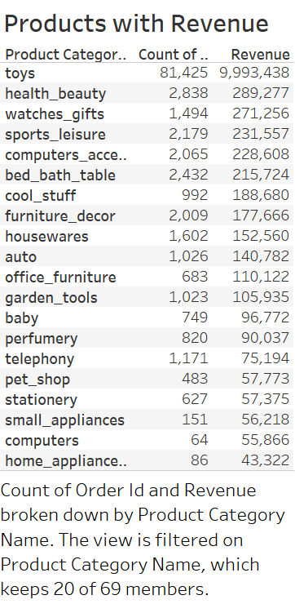
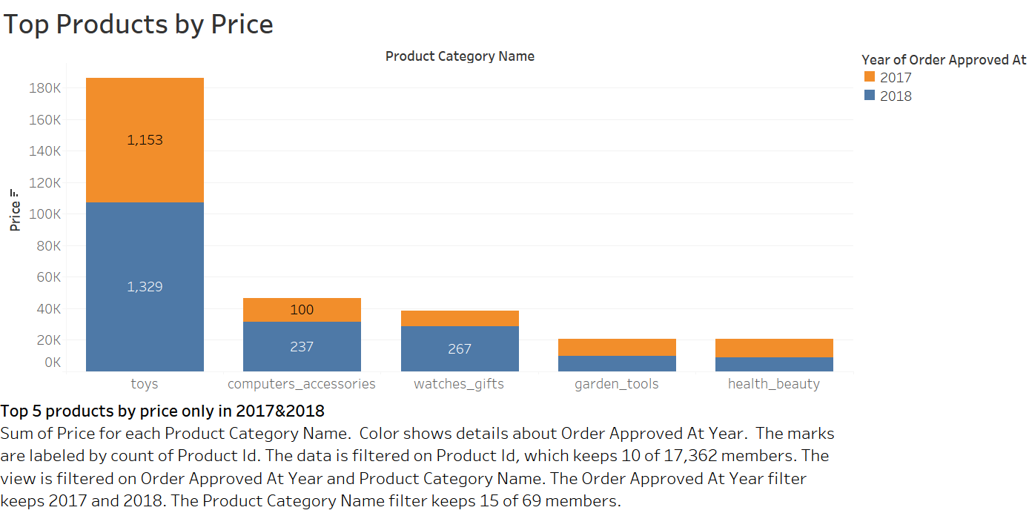
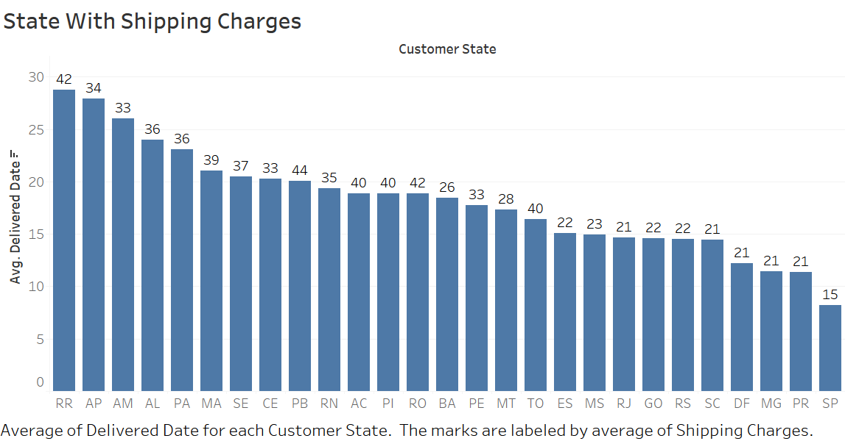
Products with Price, shipping Charges and Revenue

Slide 9
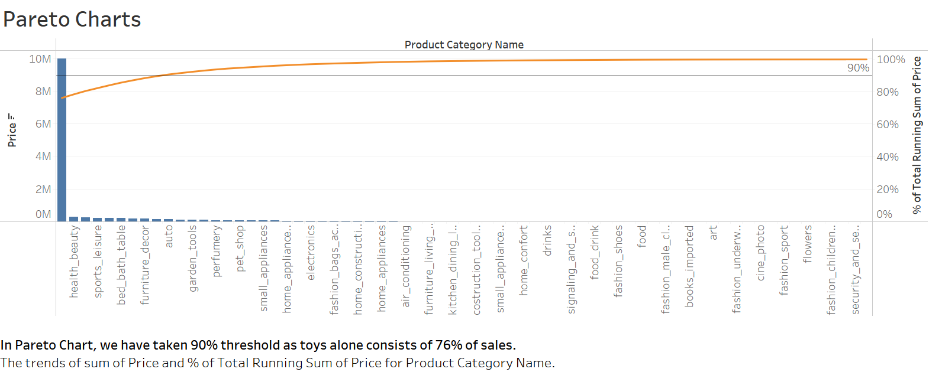
MARKET BASKET ANALYSIS
Market Basket Analysis is one of the key techniques used by large retailers to uncover associations between items. It works by looking for combinations of items that occur together frequently in transactions. To put it another way, it allows retailers to identify relationships between the items that people buy.
As more than 75% of the revenue is generated by toys, hence for this analysis we have taken 90% threshold value for market basket analysis.
Due to this we will be able to perform market basket analysis with 10 products.

Slide 10
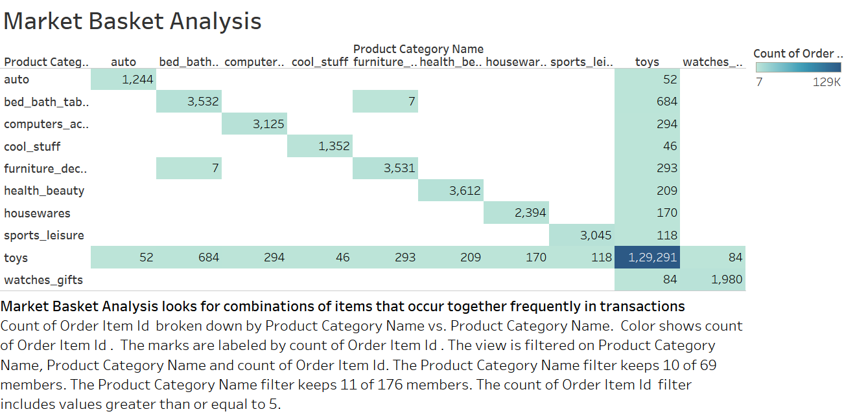
Market Basket Analysis
Here we can clearly see that products that sell good together is any product that is with toys.
Combination of products with toys is much better than any other combination.
Combination that has been sold more than 5 times and does not include toys is Furniture Décor – Bed Bath Table.

Slide 11
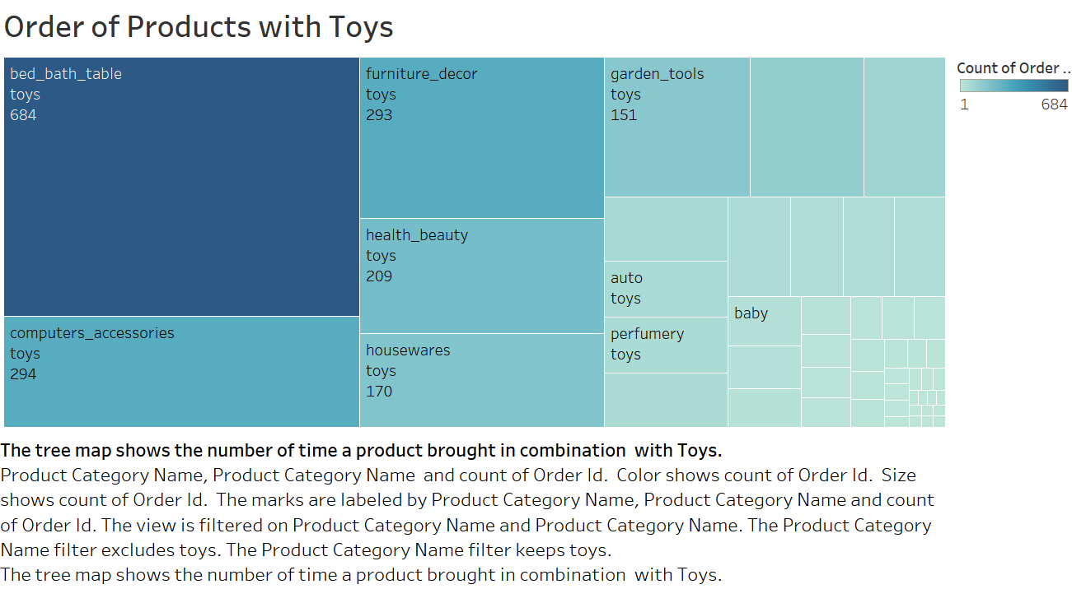
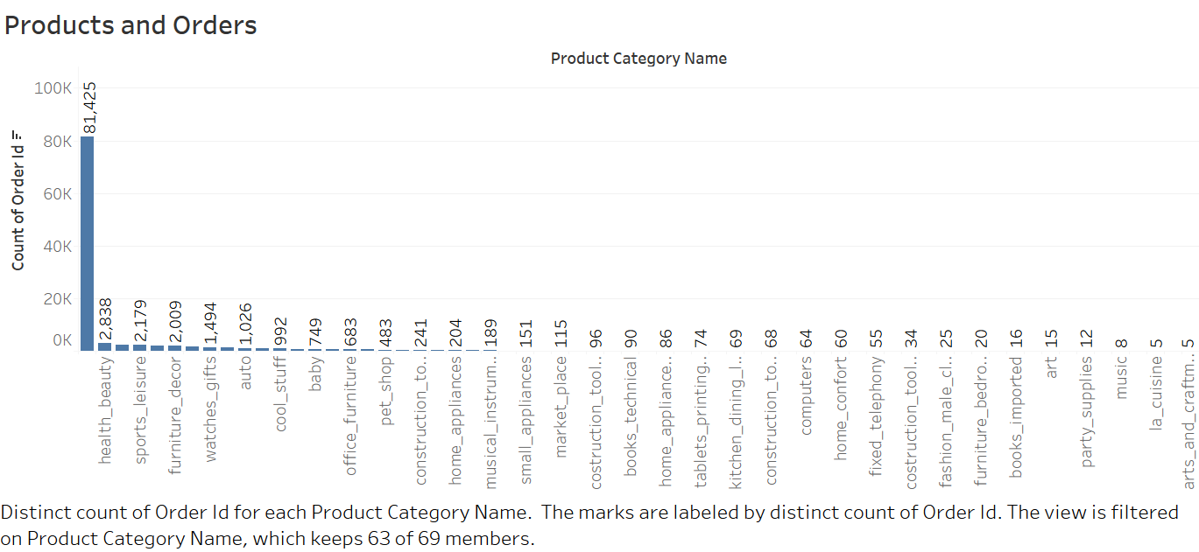

Slide 12
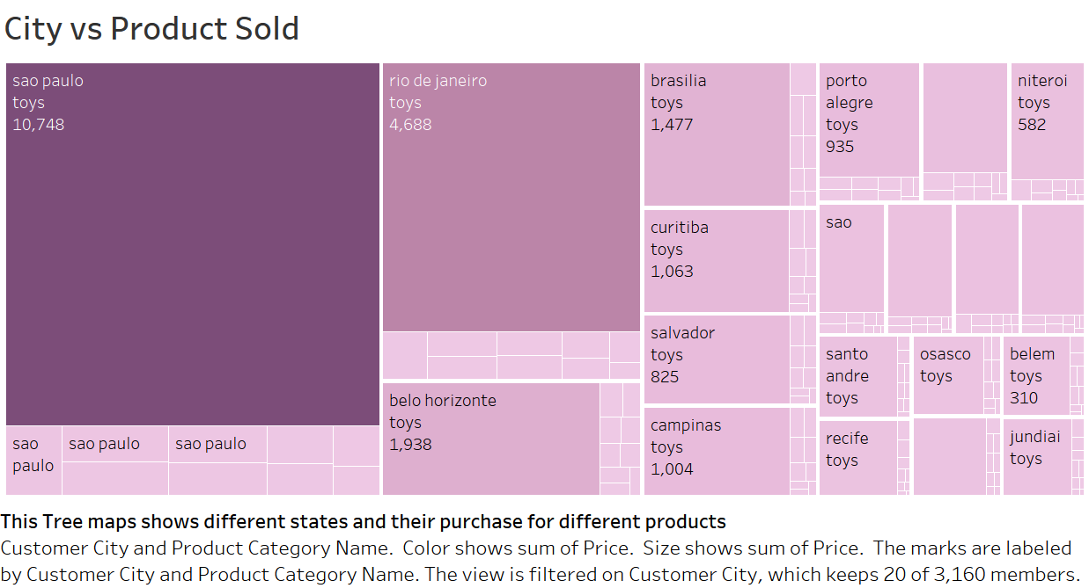
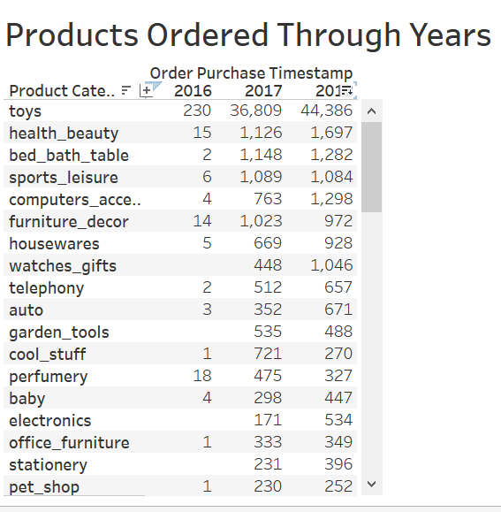
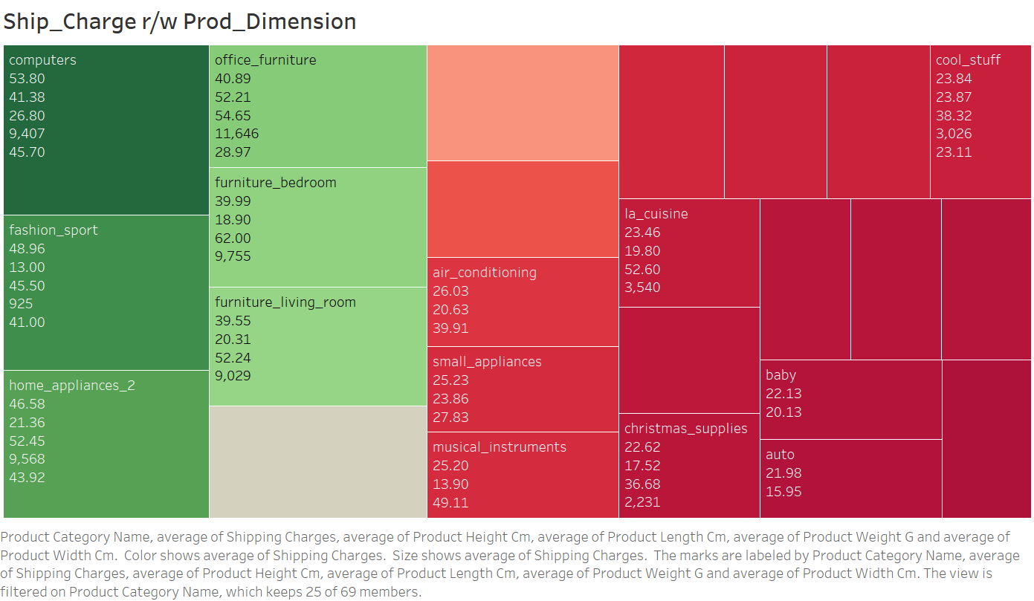

Slide 13
Recommendations
Company should focus on Retaining their frequent costumers, by giving them offers.
Products that are not very frequently brought with other products can be given in combos eg: Christmas decorations with Toys during November-January period and should not be stored during rest of the year as Christmas decorations are seasonal, where as products that not selling or selling less than 10 quantities a year should be discontinues.
Heavy products either in size or weight should be outsourced to local sellers, in this way we can save warehouse storage cost and shipping cost, which will in turn make the product value significantly less.

Slide 14
Assumptions
For this analysis, we have considered only “Delivered” products.
It is good to assume that shipping charges are given by the customers, hence no need to include it in the “Revenue”.
Assuming the warehouse is a normal sized one.

Slide 15
Summary
Giving discounts and offers can be a good way to catch the eye of customer.
Products that are selling less can be combined in combos to push their sales
Reducing shipping charges might be beneficial, at least for the products who’s shipping charges > price of that product.

Slide 16
Thank You.
OLIST
Created By -
Shivanshi Tiwari

